Slide 1
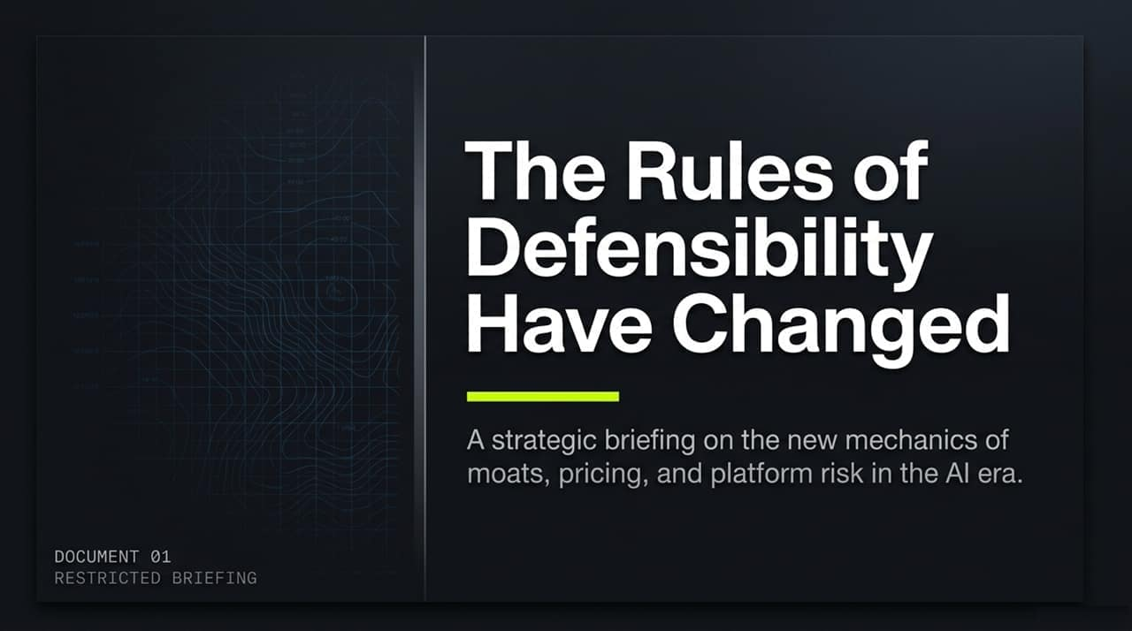
Notes:
Good morning/afternoon, everyone. Today, we’re going to discuss the fundamental shift happening across the software landscape.
Over the last decade, software defensibility was largely built on distribution advantages and incremental workflow optimization. In the AI era, however, the barrier to producing software has plummeted dramatically.
We are seeing a "supply-side boom" where anyone can build or "vibe code" an application quickly.
Because software itself can now execute actual work rather than just assist humans, the rules around moats, pricing structures, and platform risks must be completely rewritten.
Over the next few minutes, we will walk through a strategic framework to help startups navigate this shift, avoid structural traps, and build durable, high-margin software companies.
https://youtube.com/watch?v=fgzr3PhzIMk

Slide 2
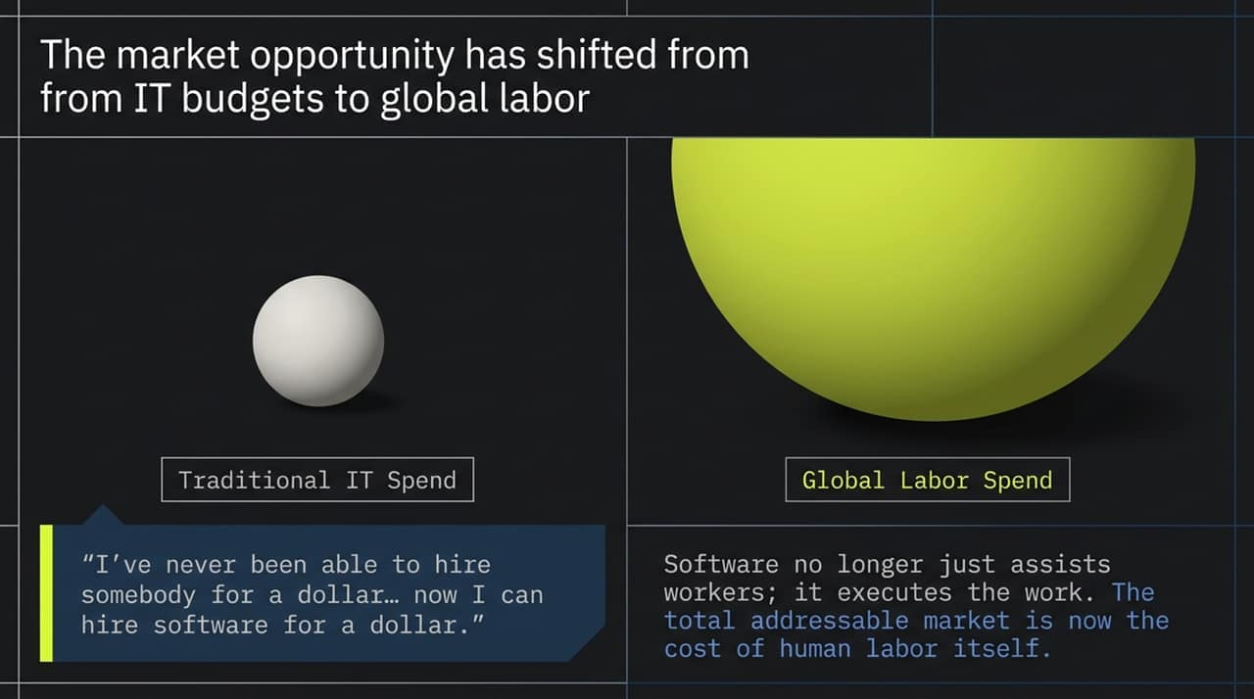
Notes:
The most important economic shift in this product cycle is how we calculate Total Addressable Market (TAM).
Traditionally, software companies competed for enterprise IT budgets, which represent a fraction of corporate spending. Software was bought to make employees slightly more efficient.
Today, software is shifting from assisting workers to executing the actual labor. This moves software straight into Global Labor Spend—a market orders of magnitude larger.
As the quote from the briefing highlights: "I’ve never been able to hire somebody for a dollar... now I can hire software for a dollar."
When tasks can be performed by software at near-zero marginal cost, businesses don't just eliminate existing jobs—they unlock vast backlogs of work that were previously too expensive or complex to assign to human workers.

Slide 3
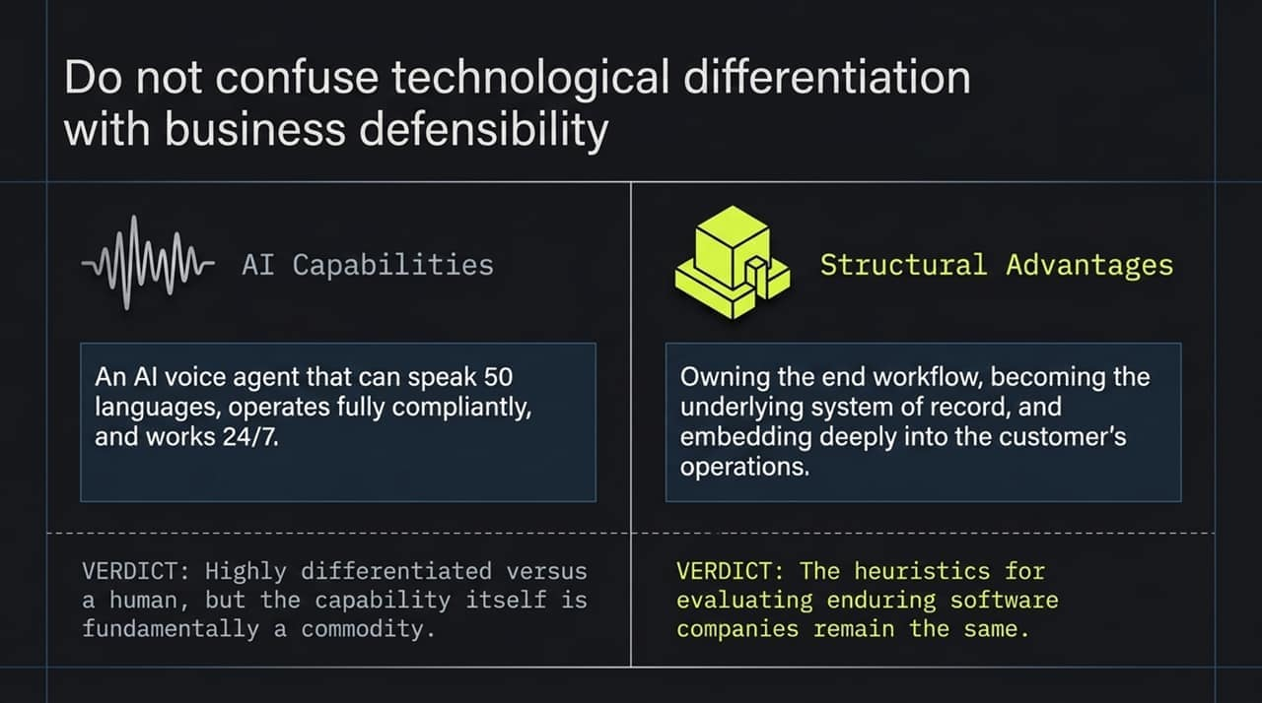
Notes:
It is critical that we do not confuse technological differentiation with business defensibility.
AI Capabilities (Differentiation): Take a voice agent that speaks 50 languages, operates 24/7, and complies perfectly with local regulations. While highly differentiated compared to a human employee, the underlying technology capability itself is fundamentally a commodity. Because AI models are widely accessible, competitors can replicate raw capabilities very quickly.
Structural Advantages (Defensibility): True defensibility doesn't come from the raw model output. It comes from owning the end workflow, becoming the underlying system of record, and embedding deeply into customer operations.
The core heuristics for evaluating enduring software companies remain unchanged: deep integration, high switching costs, and network effects are still what matter.

Slide 4
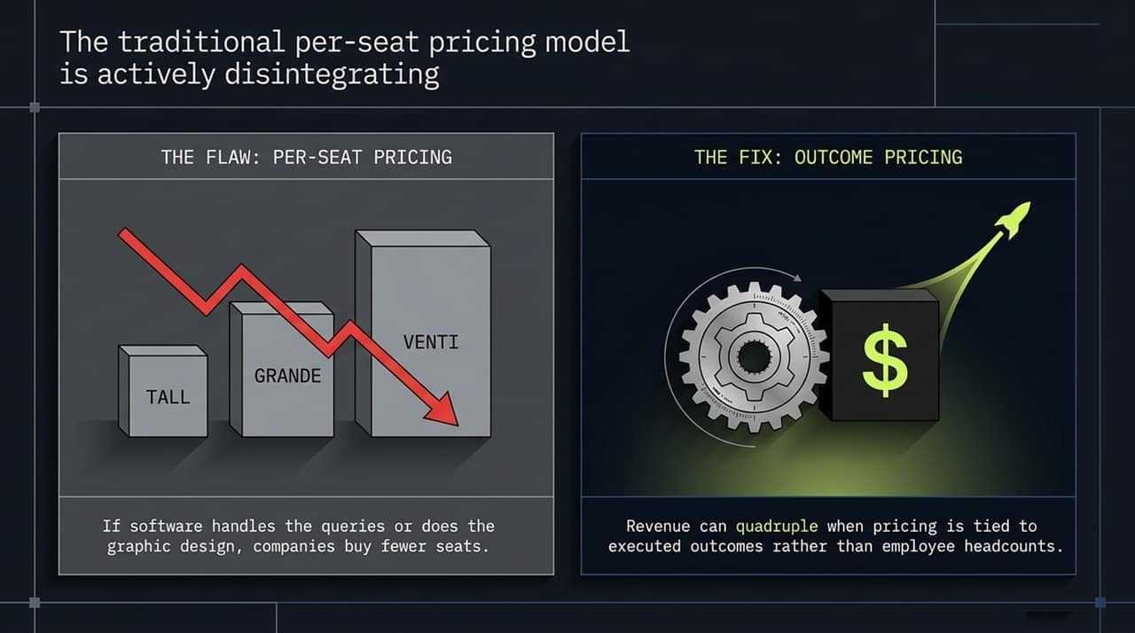
Notes:
The standard per-seat (SaaS) pricing model—what Alex Rampell calls the "Tall, Grande, Venti" model—is actively disintegrating in the AI era.
The Flaw: Per-seat pricing incentivizes customer labor efficiency. If your AI software successfully handles customer queries or generates graphics, the client inherently needs fewer human employees. Under a per-seat model, efficiency directly reduces software seat count and shrinks your revenue.
The Fix: Outcome-Based Pricing: Companies must tie pricing directly to work executed or outcomes delivered.
As highlighted in the video discussion, when software companies shift from seat billing to charging for outcomes (e.g., resolved support tickets, processed claims), revenue can quadruple while providing clear economic ROI to the client.

Slide 5
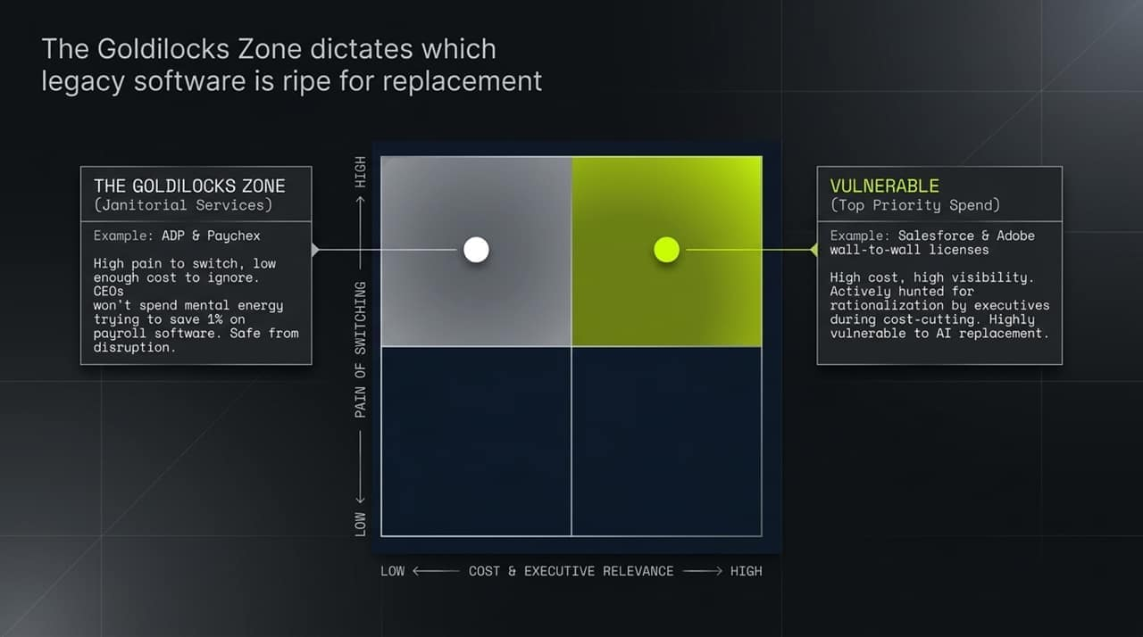
Notes:
Not all legacy software is equally vulnerable to AI disruption. To understand where opportunities lie, we use the Goldilocks Zone framework:
Safe from Disruption (Low Cost / High Switching Pain): Look at legacy payroll software like ADP or Paychex. Switching payroll causes high organizational pain, but the cost relative to total revenue is small. A CEO won't spend mental bandwidth trying to save 1% on payroll software just to get cleaner "janitorial service".
Vulnerable Targets (High Cost & Visibility): Products like Salesforce or Adobe with wall-to-wall per-seat licensing. These represent massive, highly visible line items that executives actively target during cost-cutting cycles, making them ripe for rationalization and AI replacement.

Slide 6
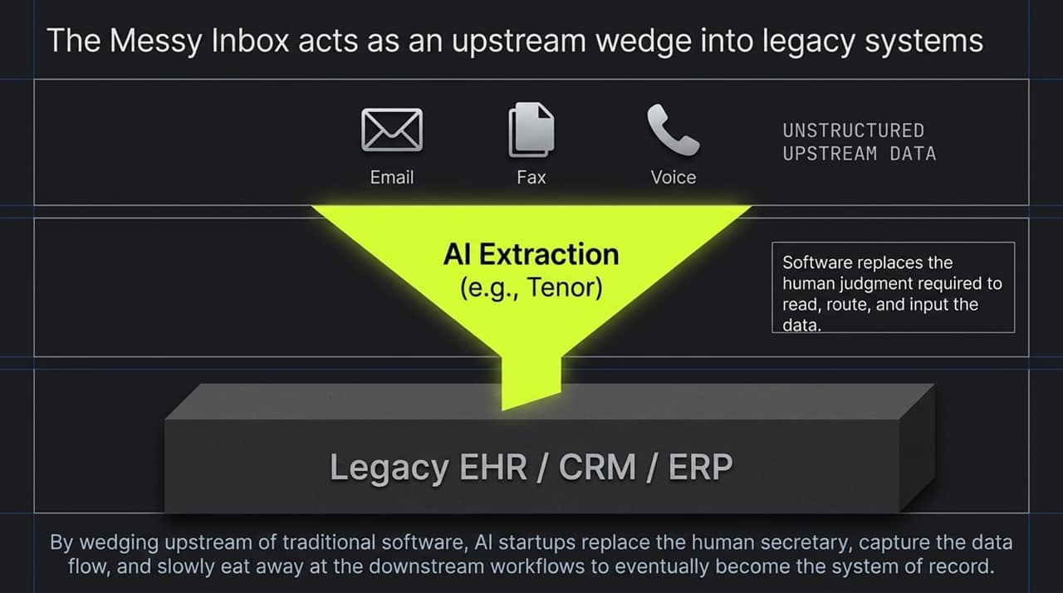
Notes:
So, how do net-new AI startups capture market share against entrenched software incumbents? They use an Upstream Wedge Strategy.
Most legacy enterprise systems (EHRs, CRMs, ERPs) rely on human labor to extract, parse, and input unstructured data.
Startups can wedge themselves upstream where unstructured data originates—such as messy inboxes, faxes, audio recordings, or emails.
By deploying AI models (like Tenor in healthcare) to parse this unstructured input, the software replaces human secretarial work.
Once a startup controls the upstream data intake and execution, it can gradually eat away at downstream workflows until it eventually replaces the legacy system of record entirely.

Slide 7
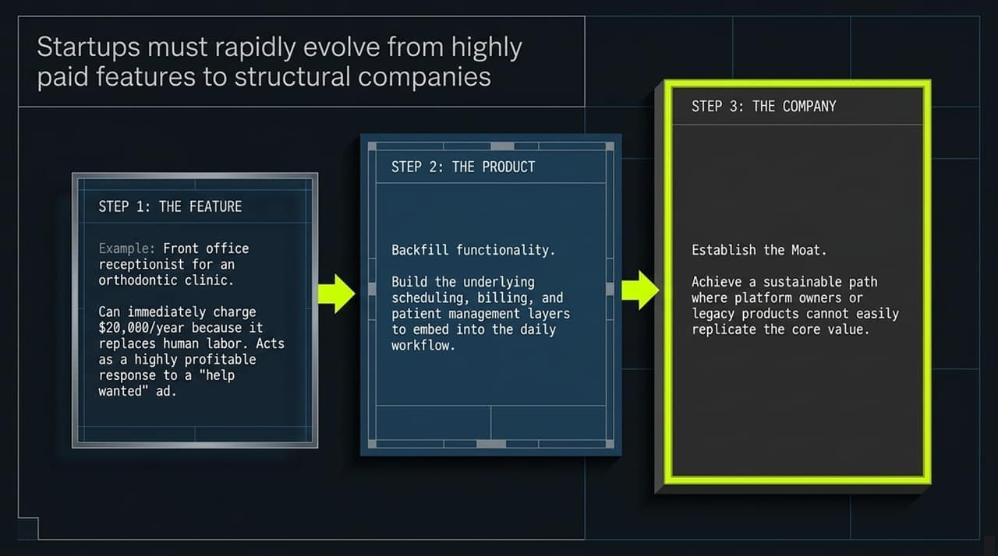
Notes:
In the AI era, startups must transition through three distinct stages at unprecedented speed:
Step 1: The Feature (The Hook): Startups often enter the market as a high-revenue feature—such as an automated front-office receptionist for orthodontic clinics. Because it directly replaces expensive human labor, startups can immediately charge premium prices (e.g., $20,000/year).
Step 2: The Product (Backfilling): Startups cannot stop at being a feature; platform owners will eventually attempt to replicate simple capabilities. They must quickly backfill core features—building underlying scheduling, billing, and management tools into daily operations.
Step 3: The Company (Establishing the Moat): Finally, they build structural moats that make it impossible for incumbents or platform owners to displace them.

Slide 8
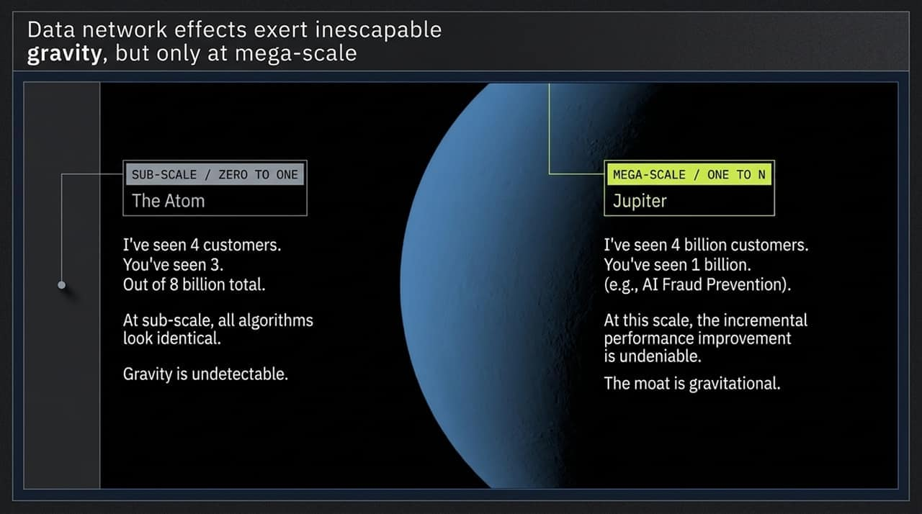
Notes:
Everyone talks about "Data Network Effects," but at a early stage, data network effects are largely invisible.
Sub-Scale (0 to 1 Phase): At the beginning, having processed 4 customers versus 3 customers out of 8 billion is irrelevant. The algorithm performance looks identical across competitors, and the "gravity" of data is undetectable.
Mega-Scale (1 to N Phase): Data gravity only becomes inescapable at mega-scale. For instance, in AI fraud prevention, a platform that has processed 4 billion records dramatically outperforms a startup that has seen 1 billion.
Takeaway: Scale creates undeniable performance advantages, but startups must survive the sub-scale phase to reach that gravitational threshold.

Slide 9
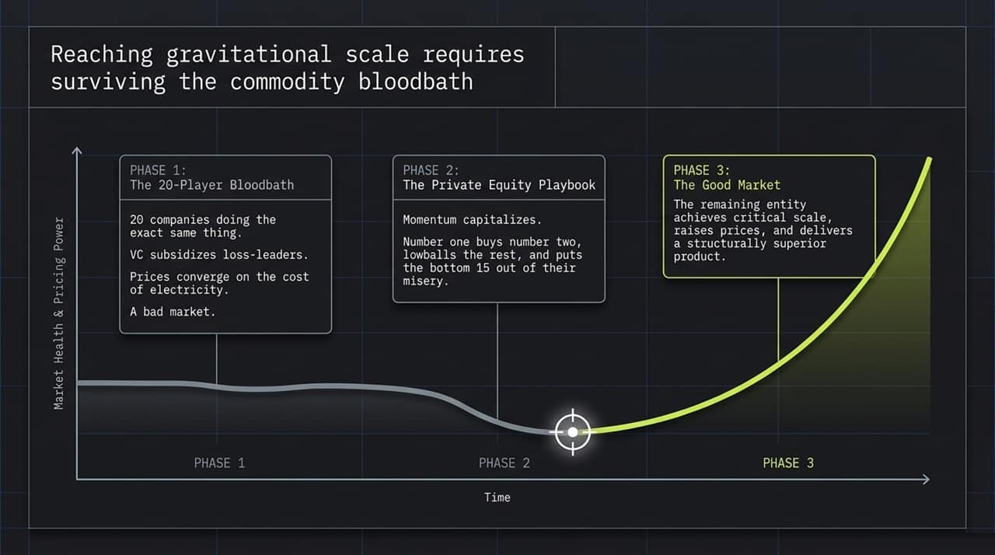
Notes:
Reaching gravitational scale requires surviving a brutal market lifecycle:
Phase 1: The 20-Player Bloodbath: Low barriers to code creation lead to 20+ startups building the exact same tool. Venture capital subsidizes loss-leaders, pushing prices down toward the cost of compute/electricity.
Phase 2: The Consolidation (PE Playbook): Momentum eventually capitalizes. Market leaders acquire immediate competitors, put sub-scale players out of business, or lowball the bottom 15.
Phase 3: The Good Market: The surviving platform reaches critical scale, gains pricing power, and delivers a structurally superior product. Founders must focus heavily on velocity and execution to ensure they are the consolidator rather than the victim in Phase 2.

Slide 10
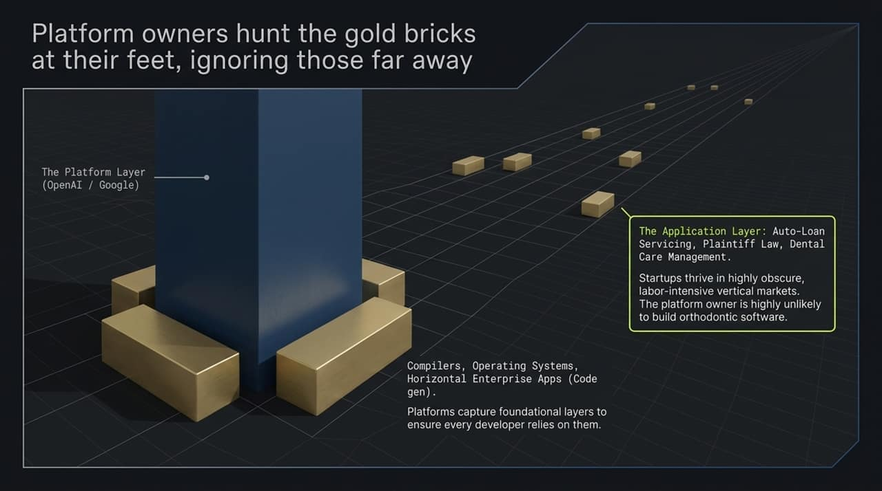
Notes:
When choosing markets, founders must carefully evaluate platform risk from foundation model providers like OpenAI, Anthropic, or Google.
Platform Priorities: Platform owners focus on capturing general, horizontal layers (compilers, operating systems, horizontal code gen, general AI assistants). These are the "gold bricks at their feet."
Vertical Application Opportunity: Platform owners will not spend resources building niche vertical applications—like auto-loan servicing, plaintiff legal drafting, or dental care management.
Strategy: Startups should "hunt gold bricks far away" by focusing on obscure, labor-intensive vertical niches where foundation model providers are highly unlikely to compete.

Slide 11
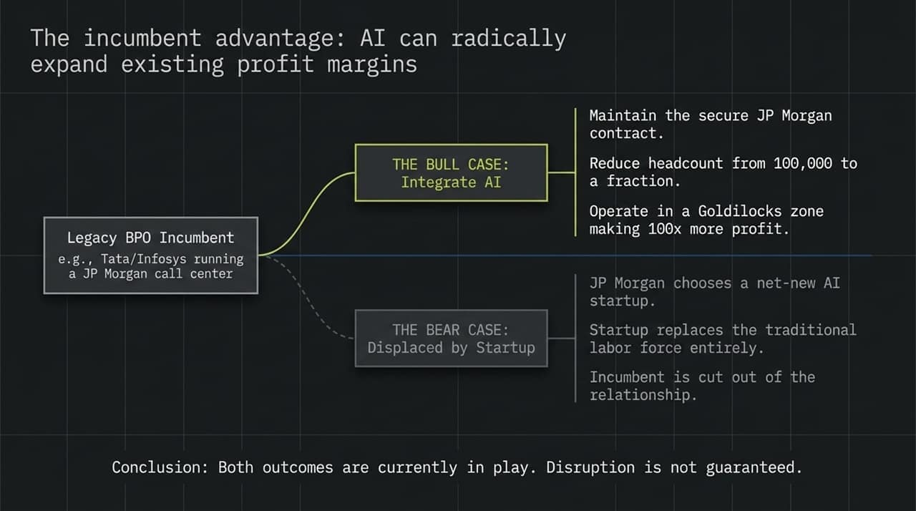
Notes:
Do AI-native startups automatically disrupt legacy BPO (Business Process Outsourcing) and software incumbents? Not necessarily.
The Bull Case for Incumbents: Consider BPO giants like Tata or Infosys running corporate call centers. They already hold trust, compliance clearances, and deeply integrated contracts with enterprises. By integrating AI internally, they can reduce workforce headcount from 100,000 to a fraction, dramatically boosting profit margins while retaining client relationships.
The Bear Case for Incumbents: Enterprise clients bypass BPOs altogether, replacing human outsourcing contracts with AI-native startups.
Both dynamics are actively unfolding today. Disruption is not guaranteed simply because a new technology exists; incumbents with distribution and deep integrations hold a strong position.

Slide 12
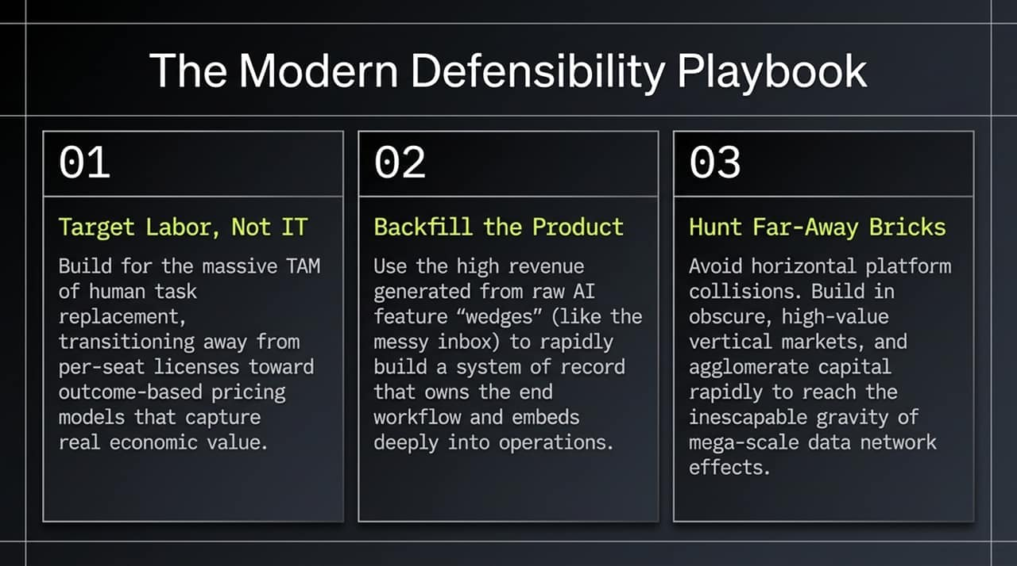
Notes:
To summarize the new defensibility playbook:
Target Labor, Not IT Budgets: Build software to capture the massive TAM of human task replacement. Pivot away from per-seat licensing to outcome-based pricing.
Backfill the Product Layer: Capitalize on high-revenue AI feature "wedges" (such as the messy inbox) to fund rapid expansion into a sticky system of record.
Hunt Far-Away Bricks: Avoid competing horizontally against platform giants. Build deep in obscure, high-value vertical markets, and aggregate scale quickly to build a data moat.

Slide 13
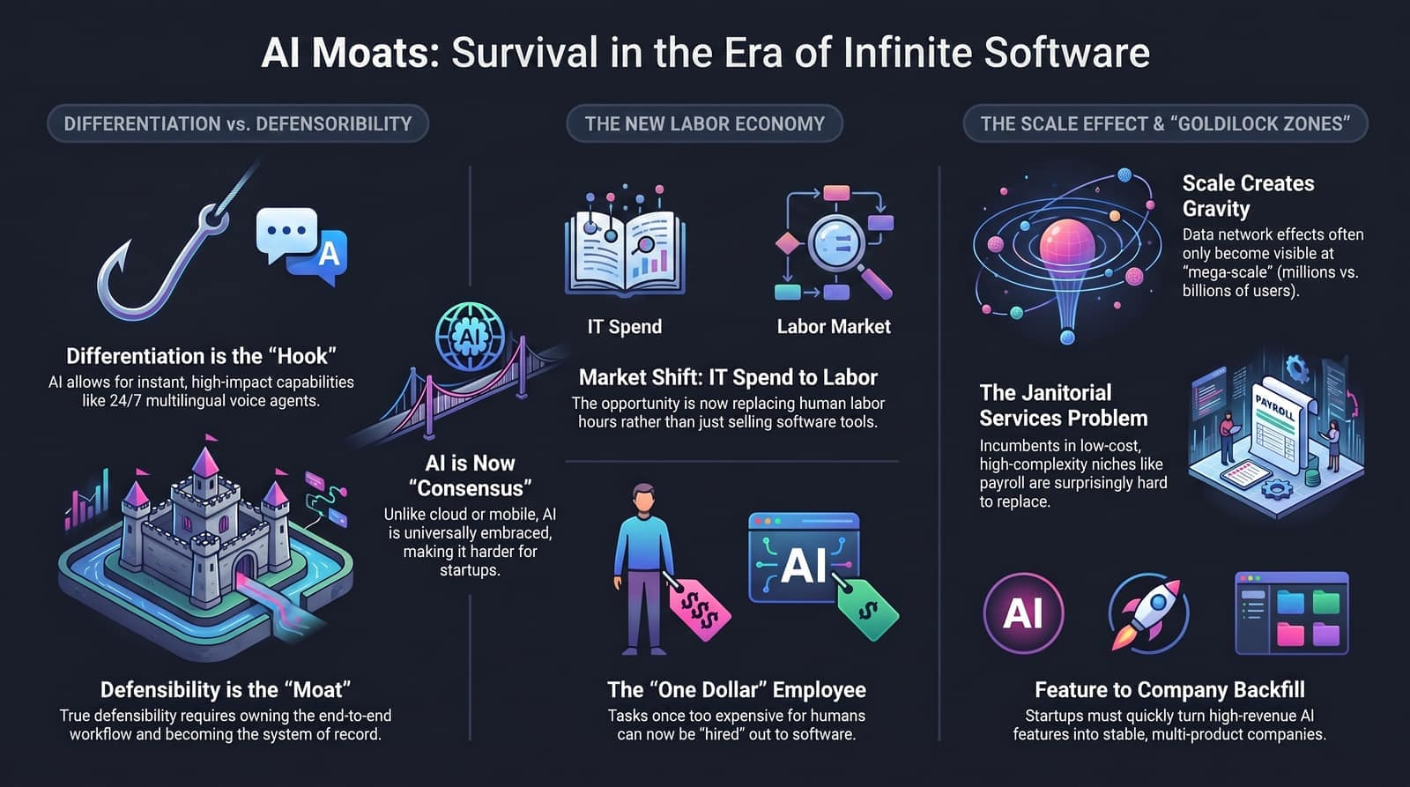
Notes:
This final conceptual map ties together everything we have discussed:
Differentiation gets your foot in the door as a "hook," but defensibility provides the lasting "moat."
Transitioning from IT budgets to labor TAM unlocks massive market opportunity.
Navigating scale effects, understanding Goldilocks zones, and building sticky systems of record are the definitive paths to surviving in the era of infinite software.
Thank you. I'm happy to open the floor to any questions or further discussion.

